Slide 1
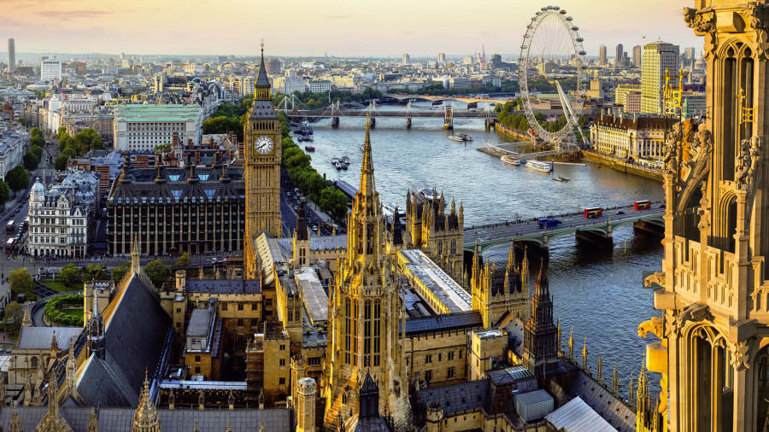
London Residential 2nd June – 6th June 2025

Slide 2
The London Adventure
Educational benefits:​
History​
Geography​
Maths​
Literacy and Oracy​
Science​
PSHE​
Physical Exercise​
Life skills
Personal benefits:​
Builds confidence ​
Builds self esteem​
Develops independence​
Develops responsibility
Overcoming challenges​
Supports with transition​
Resilience​
Social benefits:​
Cooperation​
Teamwork​
Compromise​
Compassion​
Social etiquette​
Shared memories​
Deeper relationships​

Slide 3
Staff
Mr Manning
Miss Voss
Mrs Cook
Mrs Hargreaves
Mrs Wilmshurst-Smith

Slide 4
Transport
CMD Travel Hereford.
Private hire of the coach.
We will walk a short distance from the coach drop off point to the hostel so please ensure your child has one bag which they are able to carry.

Slide 5
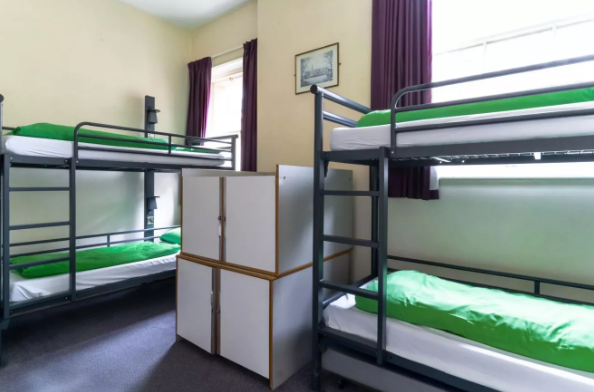
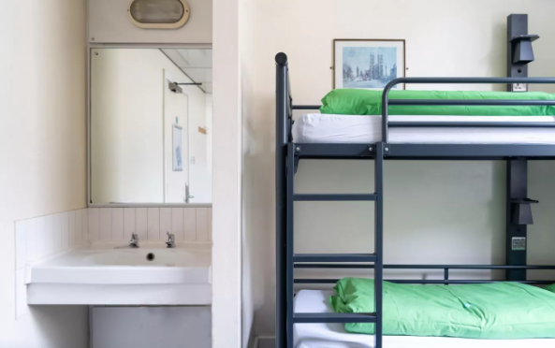
Accommodation
London St Paul's YHA
Children are in rooms which range from 4 to 6 beds.
Staff rooms are located next to the children’s rooms.
Children have shared shower and toilet facilities on secure floor of hostel

Slide 6
Meals
The hostel will provide the children with a packed lunch for Tuesday-Friday. Please provide your children with a packed lunch for the Monday in disposable packaging.
The children will choose their sandwich filling in advance.
Meal options will also be chosen in advance.

Slide 7
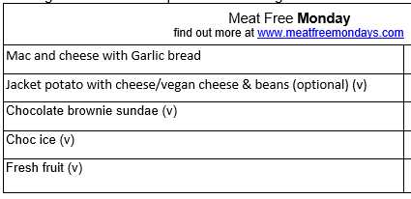
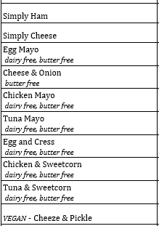
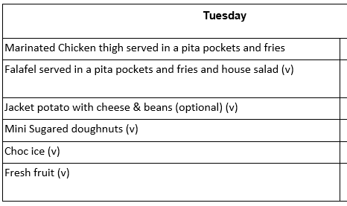
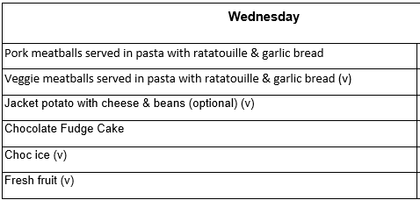
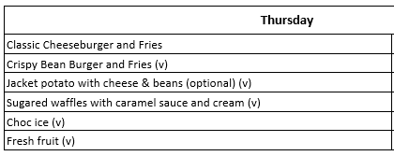
Meals
Packed Lunches

Slide 8
London 2025
Suggested kit list
Please make sure all items on the list are clearly labelled. All bed linen is provided. When packing please try to bear in mind the weather forecast and adjust your clothing accordingly. In addition, children must be able to carry their own luggage.
Packed lunch for Monday- please provide this in disposable packaging (not lunchboxes).
Clothing – several complete changes of clothes, including warm hoodies/sweatshirts, jeans or trousers- 2 pairs minimum, shorts, t-shirts, and enough socks and underwear for every day.
Smart / casual clothing for our trip to the theatre.
Waterproof coat with hood.
Sensible walking shoes / trainers.
Wash bag with toothbrush, toothpaste, shampoo / shower gel, comb and/or brush, roll-on deodorant, tissues. Please don’t bring aerosols as some people who have asthma are affected by them.
Night wear / pyjamas.
Towel.
Shoulder bag/backpack to hold lunch etc.
Clearly named plastic drinks bottle.
A book or books, a cuddly toy and a small quiet game such as cards.
Some black plastic bin liners for dirty washing.
Lip balm, sun cream or lotion.
No mobile phones.
iPods, mp3 players and cameras can be brought for the journey to and from London at owners’ risk. Please make sure that these devices do not have WiFi enabled.
A prepaid card for spending money (maximum of £50)
All medicine, including travel sickness tablets, to be handed to Mr Manning.
A sensible amount of sweets.
Ear plugs as the cathedral bells run through the night and may be noisy
A watch (without wifi enabled)
Please also send a stamp and your address so that the children can write you a postcard

Slide 9
Prepaid cards
Most places in London, since the pandemic, are now not taking cash.
A variety of pre-paid cards are available online (e.g. Go Henry), but most have an annual subscription. There are also Mastercard gift cards (like credit cards) that can be used anywhere. These can be purchased in most supermarkets.
When deciding on spending money we are mindful of additional costs to parents, so we suggest £10.00 per day which equates to a maximum of £50.

Slide 10
Itinerary
Monday 2nd June
8.00am Depart Lea
8.30am Depart GGS
12.30am Lunch @ Queen Mary's Rose Garden
1.30pm Madame Tussauds
4.30pm Arrive at YHA St Paul's
5.30pm Dinner
7.15pm Evening walk around the local area

Slide 11
Itinerary
Tuesday 3rd June
7:00am Breakfast
10.00am Westminster Abbey Tour
12.00pm Downing Street and Horse Guards
12.30pm Lunch in St. James Park
1.00pm Buckingham Palace
2.00pm The Natural History Museum
4:30pm Dinner
7.30pm Apollo Victoria Theatre to watch 'Wicked'

Slide 12
Itinerary
Wednesday 4th May
7:00am Breakfast
10.00am Imperial War Museum
1.15pm Lunch in Hyde Park
3.45pm River Cruise
4:45pm London Eye
7.00pm Dinner
7.15pm Greenwich Park

Slide 13
Itinerary
Thursday 5th June
7:00am Breakfast
10.00am The Tower of London
1.00pm Lunch
2.30pm HMS Belfast
6.00pm Dinner
7.00pm Games

Slide 14
Itinerary
Friday 6th June
8:00am Breakfast
8.45am Depart YHA
10.30pm Workshop at Harry Potter Studios
11.30pm Lunch
12:00pm Tour of Harry Potter Studios
Approx2:30pm Depart HPS
Approx 6:00pm Arrive at GGS
Approx 6:30pm Arrive Lea

Slide 15

Code of conduct
General
I agree that I will:
Behave politely and considerately towards others.
Listen carefully to, and follow any instructions given by the adults.
Dress appropriately and have the right equipment necessary for any visit.
Try to be on time for meetings, meals, the coach etc.
Always stay together with my group and never go anywhere on my own (be with at least 3 other people I know).
Not take any unnecessary risks that might put myself, or others in danger.
Look out for anything that might hurt or threaten myself, or anyone in the group and tell an adult about it.
Report any accidents immediately to an adult.

Slide 16
Code of conduct cont . . .
On the coach
I agree that I will:
Stay in my seat with my seat belt on during the journey.
Not drink on the coach (only at break stops), and leave the coach tidy and clean.
Be considerate to those sitting around me.
Not distract the driver.
Only get on and off the coach when told to by an adult.

Slide 17
Code of conduct cont . . .
In the Youth Hostel
I agree that I will:
Walk around the hostel quietly.
Use the toilet and shower rooms sensibly and leave them tidy for others.
Stay in the areas (inside or out) of the hostel as instructed by the adults.
Only allow visitors in my dormitory that are the same gender.
Not be alone in my room (always be with at least 3 other people I know).
Stay in my dormitory after ‘lights out’, unless in an emergency.
Leave the dormitory clean and tidy each morning.
Not smoke cigarettes or drink alcohol at any time

Slide 18
Medical Info
MEDICINES, TABLETS ETC.
It is essential that the school is aware if your child suffers from any medical conditions including the following. This information will of course only be used by those who need to know and kept in strict confidence
Diabetes or other long-term medical condition
Allergies (penicillin, antiseptic creams, food, rashes, stings)
Asthma/Hay fever
Ear or eye complaints
Migraine
Bed wetting
Travel sickness

Slide 19
To do:
Talk with your child about the Code of Conduct and discuss the expectations of behaviour with them.
Get your child to pack their bag/case with you. They will be responsible for their belongings while they are away, so it is good for them to be familiar with what they have.
Include a bin bag in your child's luggage so that they can use it to put any worn/dirty clothes in.
Make sure that on the morning that we travel, any medication is clearly labelled (name, dosage etc) and given to Mrs Cook.

Slide 20

Thank you for your time. Any questions?

